Slide 1
EEG MVPA scripts 1.0 OUTDATED, A NEW VERSION IS DUE
Johannes Fahrenfort

Slide 2
What we’ll cover
Analysis
Visualization and statistics
Just very briefly:
How this works with Lisa computing grid

Slide 3
scripts
Not yet on Github (but this is on my to do list)
Freely available, I can give you non-write dropbox shared access
If you need support, I am willing and able
For considerable help at any phase, co-authorship would be much appreciated

Slide 4

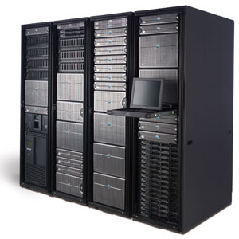
Workflow
No GUI
Lisa cluster
Local machine
Preprocessing
MVPA analysis
Visualization
Group stats
Preprocessing
MVPA analysis

Slide 5
Pre-processing
Up to you, as long as the data are EEGlab format (.set files)
I have found that removing eye-blinks has very little (=no) impact on classification accuracy, but my tasks have occipital sources of course
My personal pipeline:
Resample to 512 Hz (if applicable)
Highpass filter (.1 Hz)
Remove muscle artifact using customized fieldtrip script
Epoch data, use numbers for conditions

Slide 6
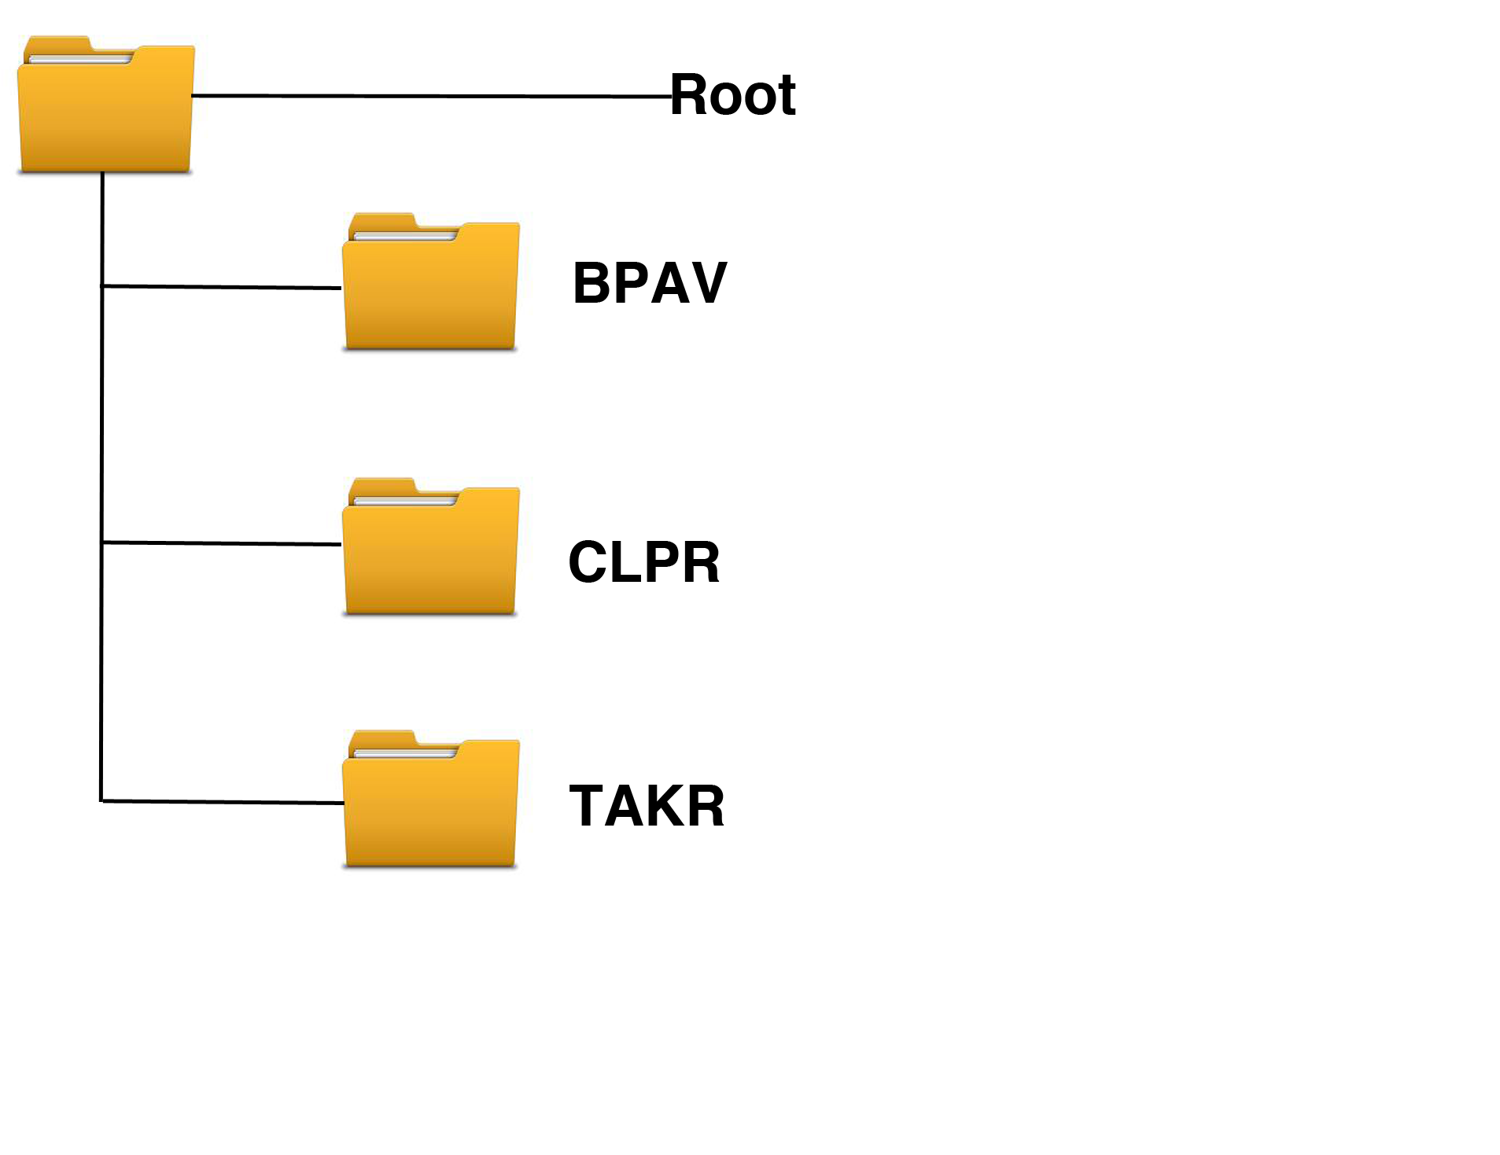
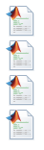
Organization of scripts
Experiment- specific scripts
Always local
Core library functions
Local and on server
scripts
run_pre_processing.m
run_RAW_eeglab_decoding.m
run_TFR_decoding.m
run_plotting_EEG.m
matlab_scripts
behavior
eeg_preprocessing
eeg_mvpa
… etc
I will give examples of these during this presentation

Slide 7
MVPA analysis
Functionality - two core functions:
classify_RAW_eeglab_data.m
classify_TFR_data_from_eeglab.m
Always the same structure:
function(filepath,filenames,outpath,<varargs>)

Slide 8
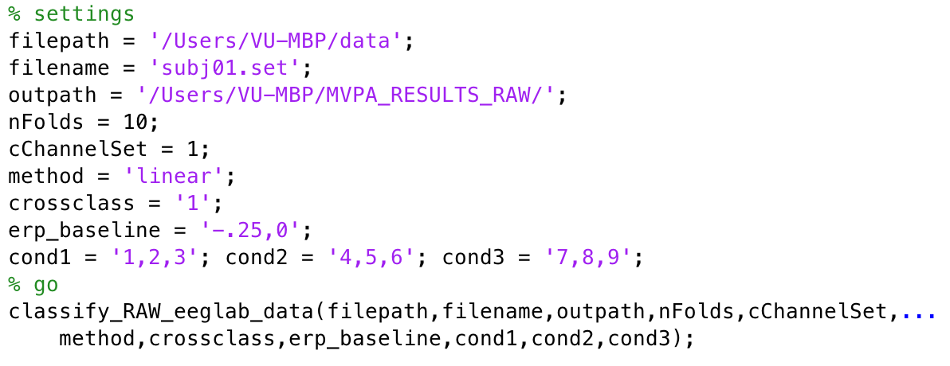

classify_RAW_eeglab_data.m
Performs MVPA analysis on eeglab data
Assume we want to perform analysis on one subject, running locally inside matlab:

Slide 9
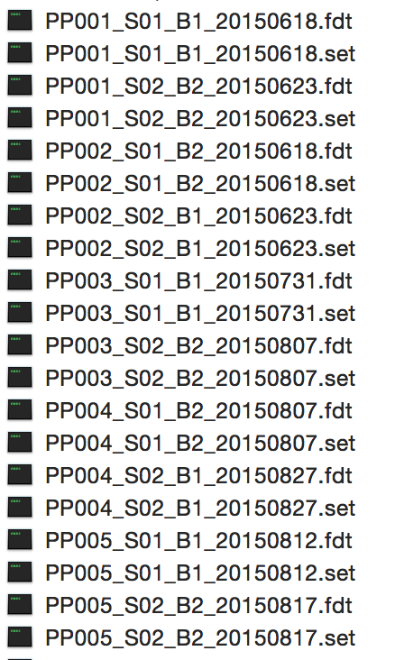
/Users/VU-MBP/data

Slide 10
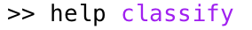
settings
nFolds = how many folds you want to use in k-fold leave-one-out procedure
cChannelset = predefined channelsets to select electrodes (1 = uses all electrodes; 2 = uses occipital electrodes, 3 = uses parietal electrodes etc.), or like this 'Oz,Pz,Iz’
method = the method the LDA uses (e.g. linear), see and other options (e.g. hr-far, bin, bintrain, bintest, randperm), see

Slide 11
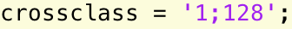
settings
crossclass = compute only along the diagonal or compute the Generalization Across Time (GAT) matrix. This takes a LOT of time. You can add a second value to downsample the signal, like this: e.g. to downsample to 128 Hz (faster).
erp_baseline = baseline that should be used for each trial, e.g. uses a baseline between -250 and 0 ms.

Slide 12
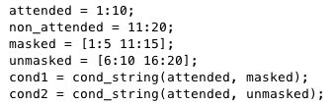
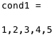
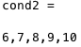
settings
conditions: indicate the condition classes you want to do classification for, should be string!
Very useful function: cond_string.m

Slide 13
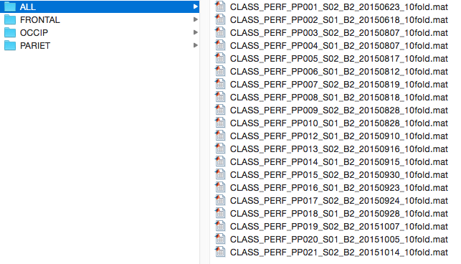
example in output folder (20 subjects)
the channel set that was used

Slide 14
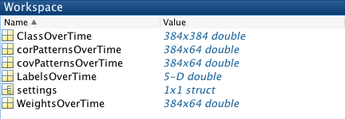
example output in matlab (1 subject)

Slide 15
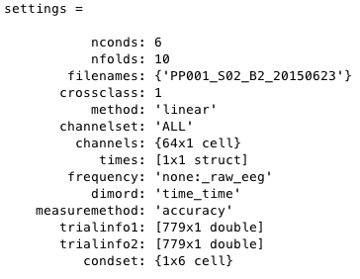
settings

Slide 16
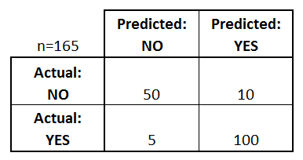
Confusion matrix
A confusion matrix is a table that is used to describe the performance of a classification model (or "classifier") on a set of test data for which the true values are known.

Slide 17
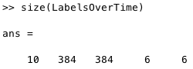
LabelsOverTime
Confusion matrix: folds * time (test) * time (train) * stimclass (actual) * stimclass (classifier)

Slide 18
ClassOverTime
Example average accuracy performance:
n= 60
Perf = 50/60 = .83
n= 105
Perf = 100/105 = .95
Average performance = (.83 + .95)/2 = .89
(so NOT 150/165 = .91!)

Slide 19
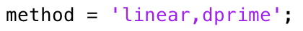
ClassOverTime
You can also compute hr-far, d’ and other SDT measures (see help). This can only be done when you have only signal and noise. To do this, specify: or When you do this, the first label should always be the signal, and the second label the noise stimulus!

Slide 20
ClassOverTime

Slide 21
classify_TFR_data_from_eeglab.m
The same principle, but now for time frequency
This is a wrapper function which internally uses classify_TFR_data.m and compute_TFR_from_eeglab.m
For help on MVPA settings do:
For TFR settings do (and/or modify):

Slide 22
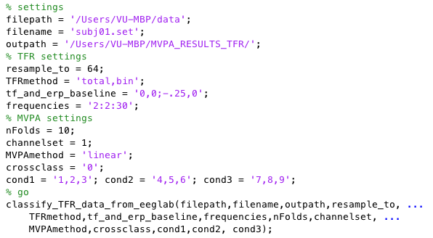
classify_TFR_data_from_eeglab.m
Running locally inside matlab:
Other options are:
‘evoked’ and
‘induced’ power

Slide 23
TFR settings
resample_to = New sampling rate for the TFR analysis. Since the TFR signal is already intrinsically temporally smoothed, you don’t require all time samples.
TFRmethod: total, evoked or induced, do you want total, evoked or induced TFRs. bin: do you want to take the average of the condition labels in each condition.
Frequencies: can run up to 100, take frequency steps of 2.

Slide 24
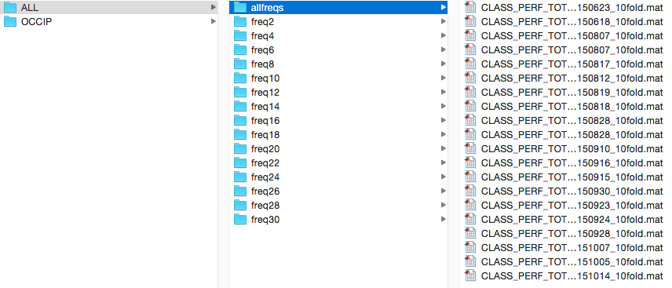
example in output folder (20 subjects)
frequency * time, all frequencies
time * time, separately for each frequency

Slide 25
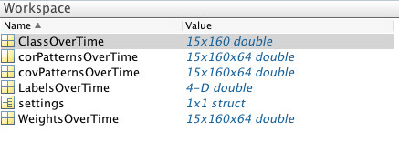
example output (1 subject)

Slide 26
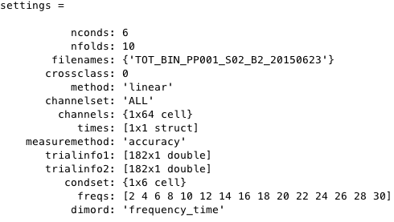
settings

Slide 27
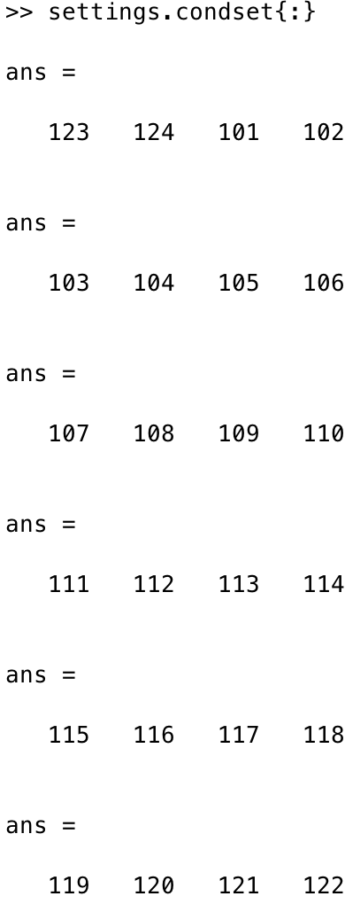
settings
cond1
cond2
cond3
cond4
cond5
cond6

Slide 28
ClassOverTime

Slide 29
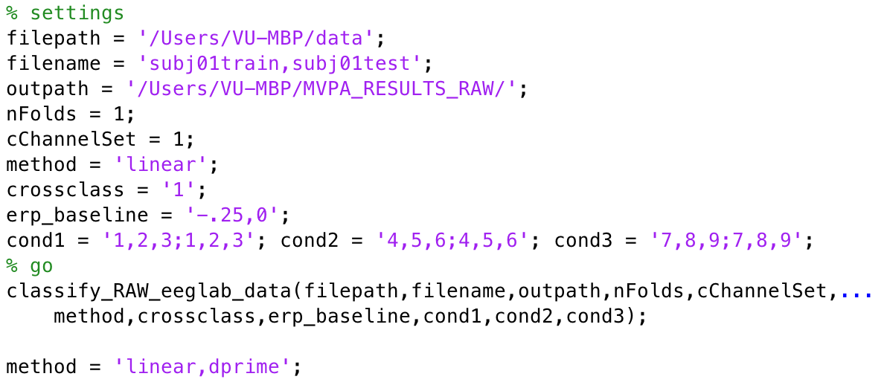
Things to note
You can also indicate that you want to use a different dataset for training and for testing
For example like this:
training file testing file
training labels testing labels

Slide 30
Group statistics and plotting
Statistics
RAW:
2D (only diagonal)
3D (Generalization Across Time: GAT)
TFR:
3D (frequency-time)
3D (GAT, for a specific frequency)

Slide 31
Three core functions
Functionality: computing group averages + stats and plotting the classification results + topomaps
compute_group_MVPA.m
plot_MVPA.m
plot_MVPA_weights.m
First run compute_group_MVPA, then plot the result using plot_MVPA

Slide 32
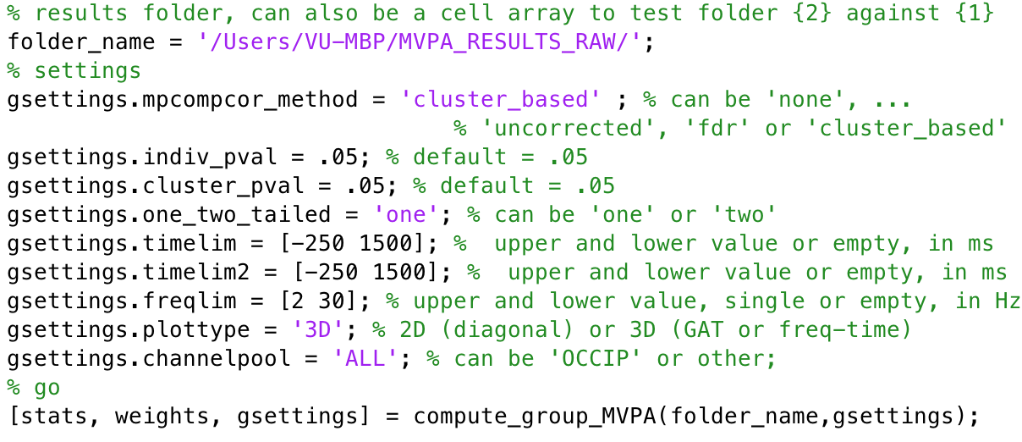
compute_group_MVPA.m
cluster_based, see: Maris, E., & Oostenveld, R. (2007). Nonparametric statistical testing of EEG- and MEG-data. Journal of Neuroscience Methods, 164(1), 177–190. http://doi.org/10.1016/J.Jneumeth.2007.03.024
fdr, see: Benjamini, Y., & Hochberg, Y. (1995). Controlling the False Discovery Rate - a practical and powerful approach to multiple testing. Journal of the Royal Statistical Society Series B-Methodological, 57(1), 289–300.

Slide 33
output of compute_group_MVPA.m
stats
weights
gsettings

Slide 34
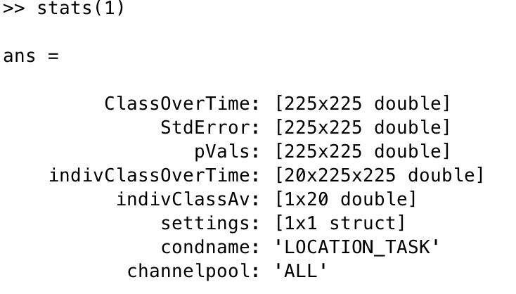
stats

Slide 35
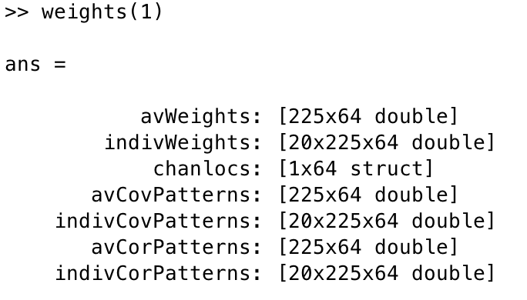
weights
CovPatterns and CorPatterns are the product of weight matrix and data covariance and correlation matrix respectively. They are interpretable as neural sources, see
Haufe, S., Meinecke, F., Goergen, K., Daehne, S., Haynes, J.-D., Blankertz, B., & Biessgmann, F. (2014). On the interpretation of weight vectors of linear models in multivariate neuroimaging. NeuroImage, 87, 96–110. http://doi.org/10.1016/j.neuroimage.2013.10.067

Slide 36
gsettings
What you specified 4 slides back

Slide 37
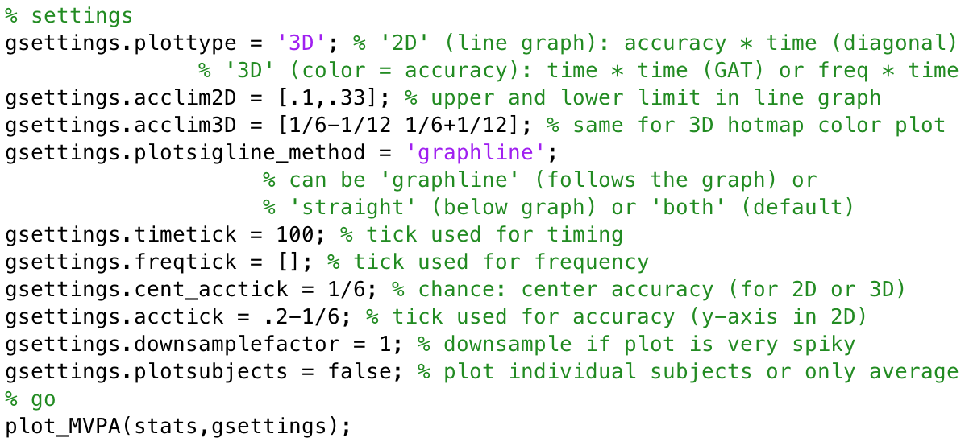
plot_MVPA.m
Add on to gsettings

Slide 38
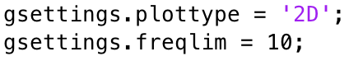
2D plot

Slide 39
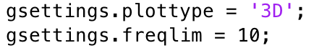
3D (GAT)

Slide 40
3D (time-frequency)

Slide 41
2D (frequency = 10)

Slide 42
3D (GAT, frequency 10 Hz)

Slide 43
Other stuff:
Extract values from your matrices: mask is a matrix that has the same size as stats.ClassOverTime, containing 1’s for regions that should be extracted and 0’s elsewhere. It outputs averages(cRoi,cCond,cSubj)

Slide 44
Weight and source topoplots
Only works properly when you include all electrodes in the MVPA analysis of course
Only makes sense when you plot the relation between two stimulus classes (scripts currently also only work when the initial analysis had two stimulus classes)

Slide 45
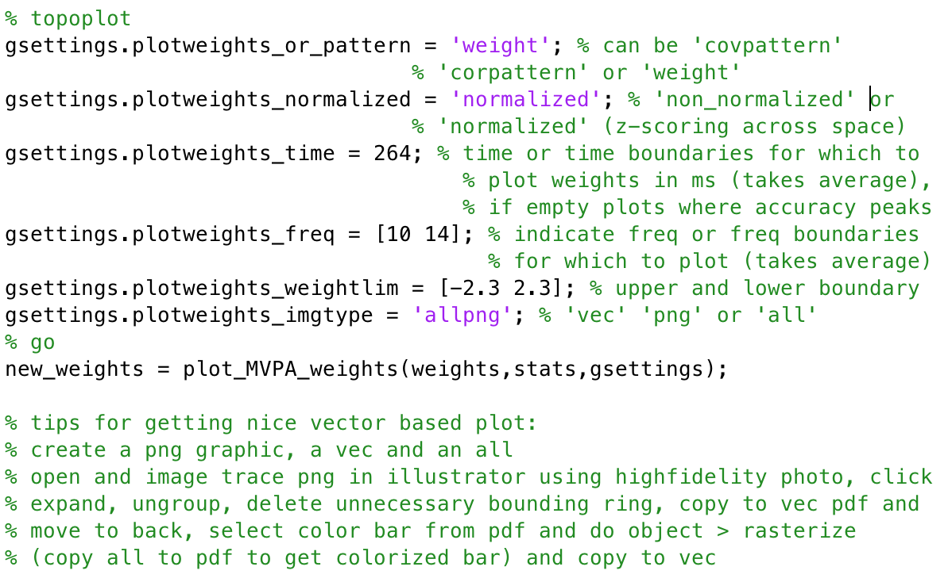
Weight and source topoplots
correlation/class separability map

Slide 46
weights (left) and correlation/class separability map(right)
Of course you can also plot based on covariance matrix, see Haufe (2014) for details

Slide 47
So what about automation, Lisa etc?
Lisa cluster
Local machine
Preprocessing
MVPA analysis
Visualization
Group stats
Preprocessing
MVPA analysis

Slide 48
Running jobs on Lisa
Functionality - two core functions:
create_qsub_files.m
run_local_instead_of_qsub.m
Always the same structure: create_qsub_files(path_to_function, function_name, qsettings, <varargs belonging to function: filepath,filenames,outpath, varargs etc>)

Slide 49
create_qsub_files.m
Allows you to run all your subjects and all your parameter combinations in a single command
Very powerful, but requires a bit of setup
Creates job on Lisa computing cluster, which can be submitted and then creates all the output at once
Will discuss this in detail another time, first process all of this, if some of you are interested, I will set up a second meeting to go over this

